Slide 1
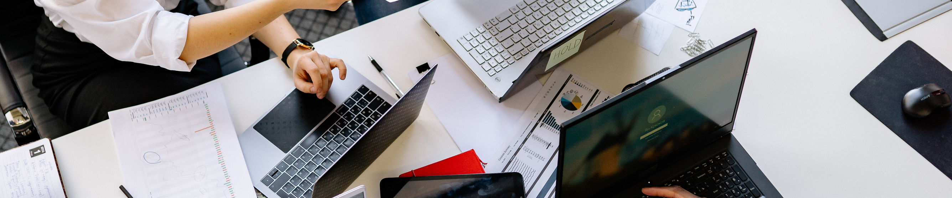


Consultancy project based on barter system
Project Supervisor: Dr. Praveen Lalwani
Project Reviewers:
Dr. V. Pandimurugan
Dr. Prashant G.K.

Slide 2

Group Members
Shikhar Pandey - 19BCE10016
Vedant Agrawal - 19BCE10057
Shreyash Singh - 19BCY10066
Patnala Saikiran - 19BCY10103
Shivam Agrawal - 19BCY10140
Krishna Agrawal - 19BCY10177
Mayank Nath Tiwary - 19BME10034
Naman Arora - 19MIM10057

Slide 3

Introduction
Since the beginning of human history, people have been trading directly in goods and services in a trading system.
We're creating an app based on the barter system.

Slide 4
What have we done?
We have created most of the UIs required for the app.
We have also interlinked them.

Slide 5
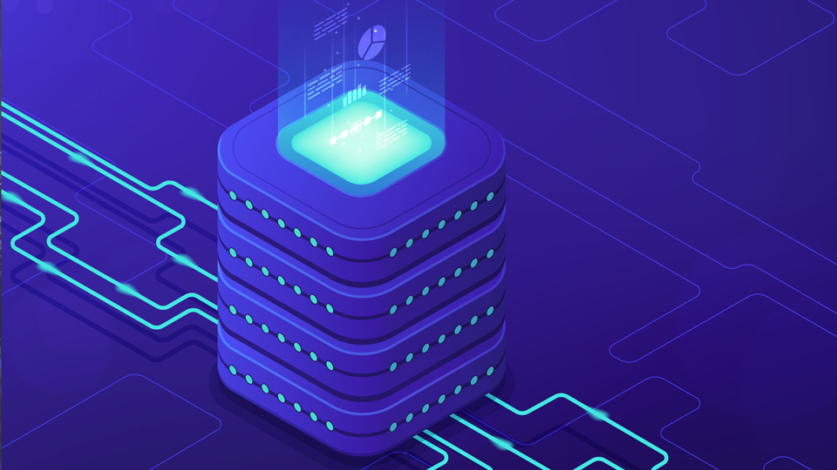
What to do next?
The next step would be completing the UI work and connecting the UIs.
Finally, we will be connecting it to the database.

Slide 6
How will it help the community?
It will allow individuals to trade items that they own but are not using for items that they need.
It will be helpful for various NGOs where people donate their personal belongings instead of money and they can trade it for whatever they need.
It can help people to save money as well.

Slide 7
Individual contribution
Each person has contributed equally.
We divided ourselves into 4 groups consisting of 2 members each.

Slide 8
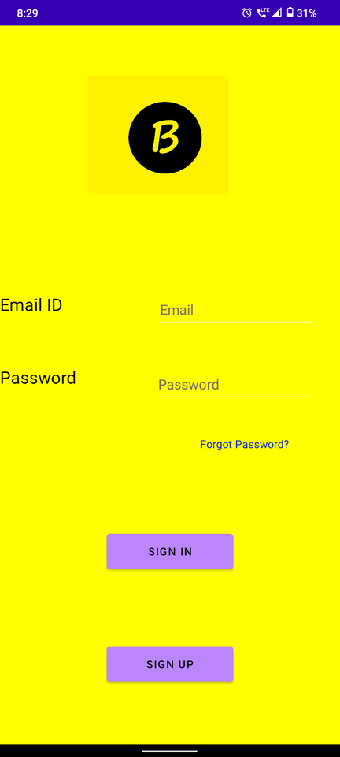
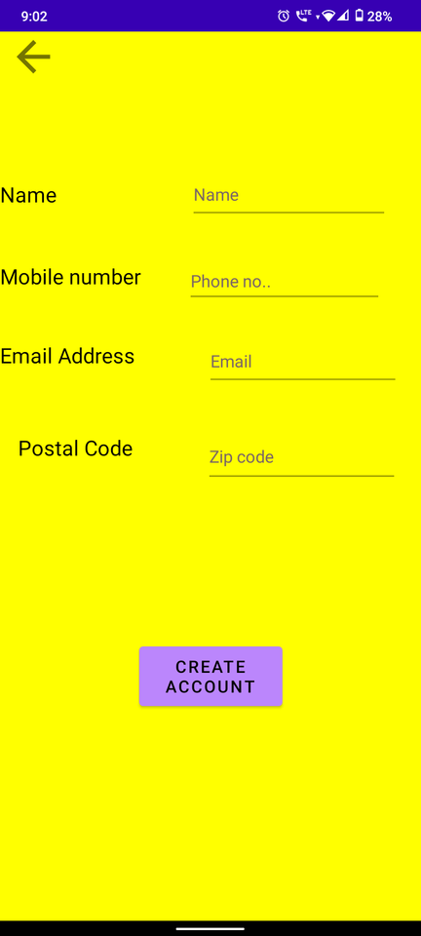
Snapshots

Slide 9
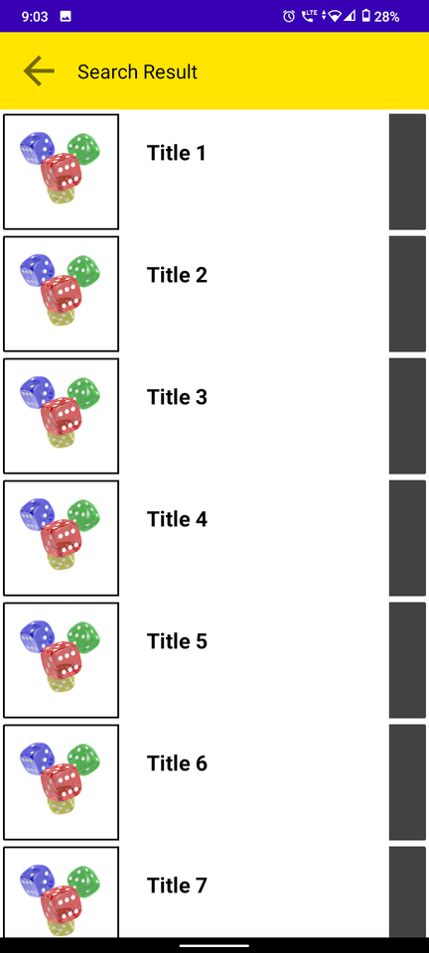
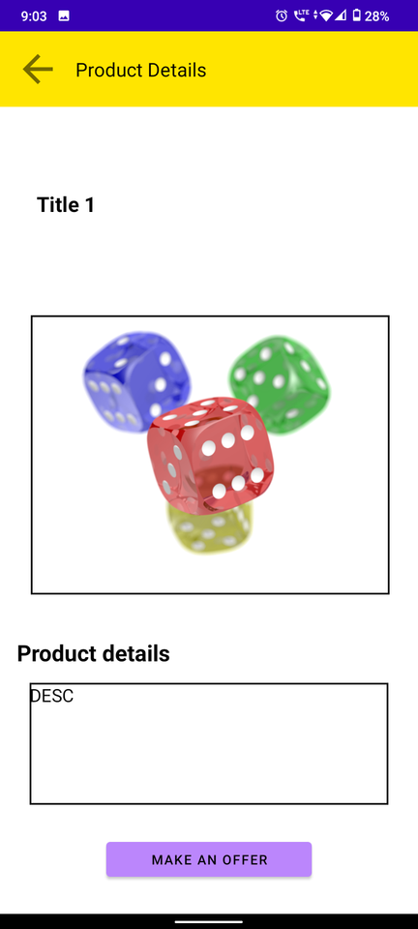
Snapshots

Slide 10
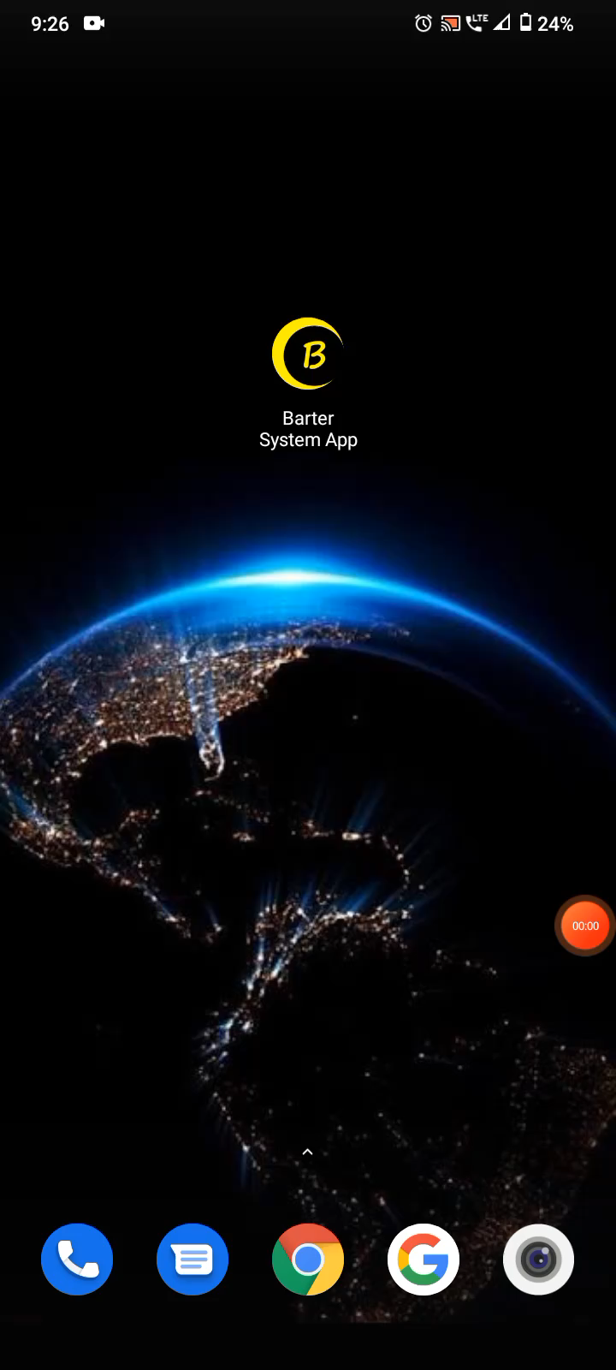

Demo video

Slide 11
THANK YOU

